Slide 1
The Inverse Problem of Thermometry
Oct. 23, 2025

Slide 2
Introduction
The core of R&D in industry is to solve various engineering problems
Engineering Problems including:
— Materials Engineering & Chemistry
— Fluid Dynamics & Aerodynamics
— Photonics & Electromagnetics
— Structural & Mechanical Engineering
— Thermal Engineering
Solving Physical Equations
— Schrödinger Equation
— Navier-Stokes Equations
— Maxwell’s Equations
— Stress Equilibrium Equation
— Heat Conduction Equation
Ground Truth
Finite Element Method
Optimization
Inverse Design
Traditional Way
Finite Difference Method
Finite Volume Method
X Manual tuning
Inefficient!
Scientific Machine Learning
Notes:
I have been received a Bachelor of Science Degree from Northwestern Polytechnical University, which is a respected and one of the leading universities in China, part of the prestigious Project 985 project.

Slide 3
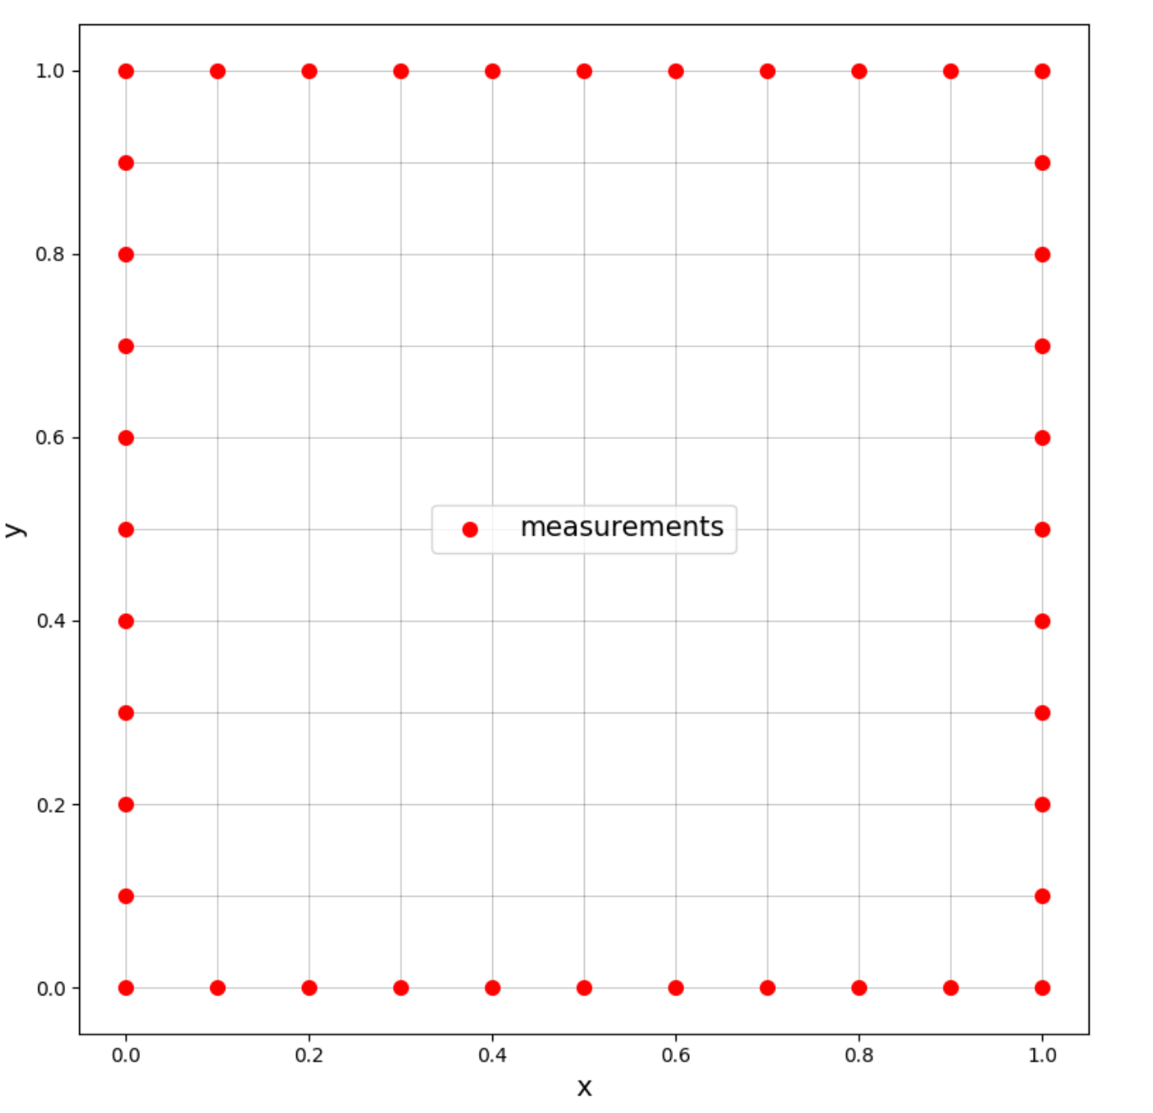
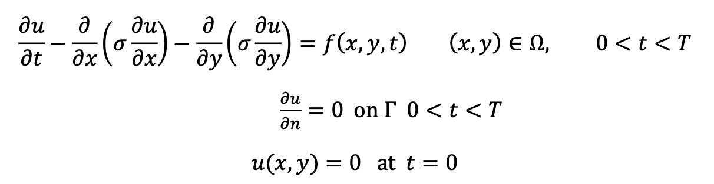
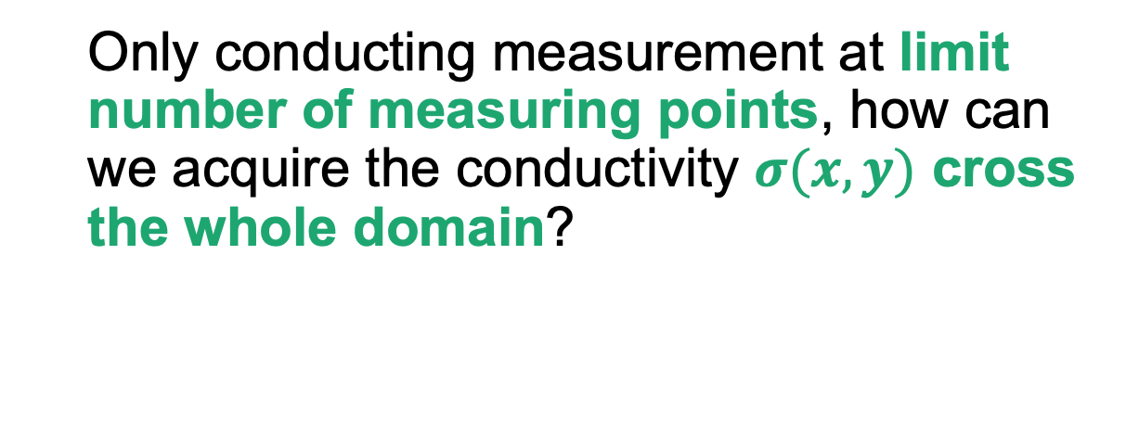
Problem Setup
Inverse Thermometry Problem
Only conducting measurement at limit number of measuring points, how can we acquire the conductivity $σ(x,y)$ cross the whole domain?
Notes:
I have been received a Bachelor of Science Degree from Northwestern Polytechnical University, which is a respected and one of the leading universities in China, part of the prestigious Project 985 project.

Slide 4
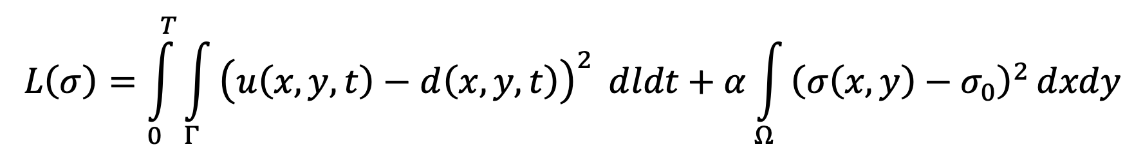
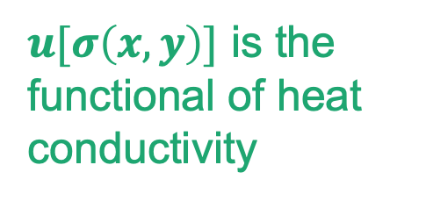
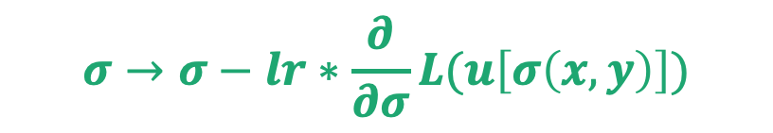

Methodology
Forward Solver
Optimization (Gradient Descent)
Finite Volume Method
+
Forward Euler
$u[σ\left(x,y\right)]$ is the functional of heat conductivity
$$σ→σ−lr∗\frac{∂}{∂σ}L(u\left[σ\left(x,y\right)\right])$$
Compute Loss
$$L(u\left[σ\left(x,y\right)\right],t)$$
3

Slide 5
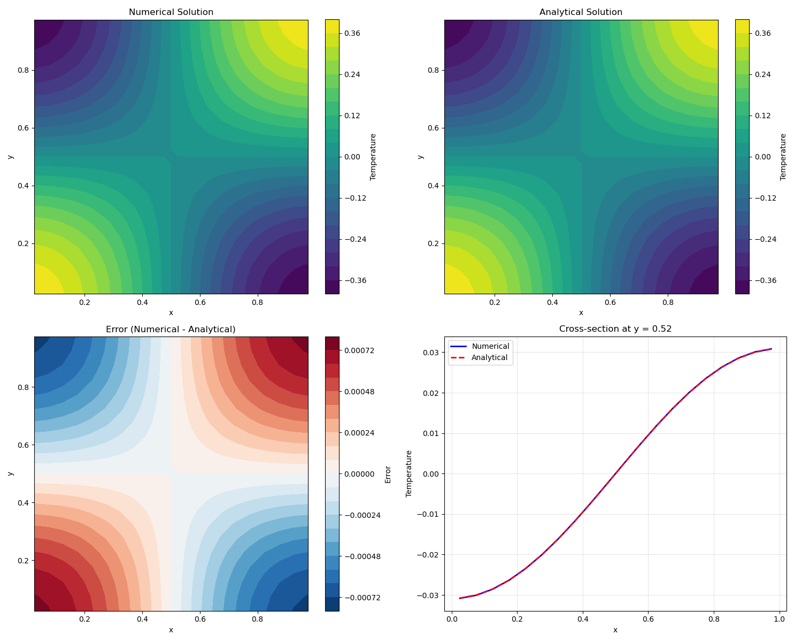
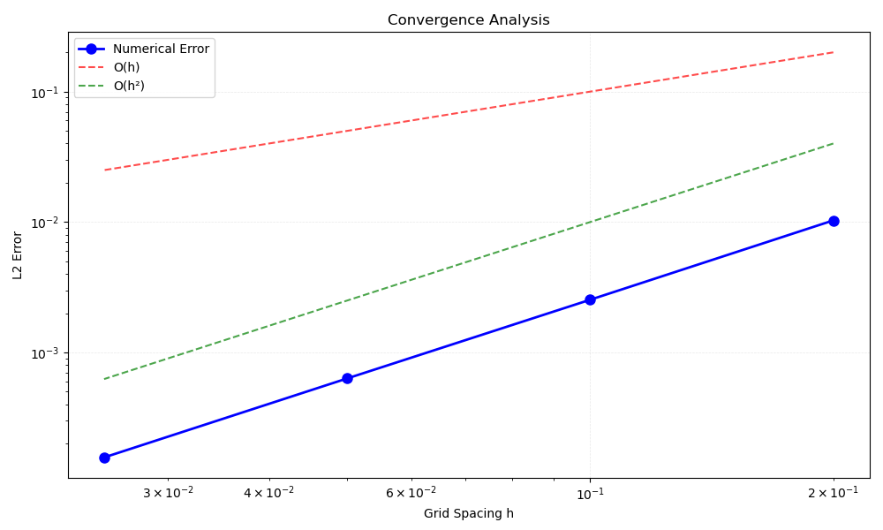
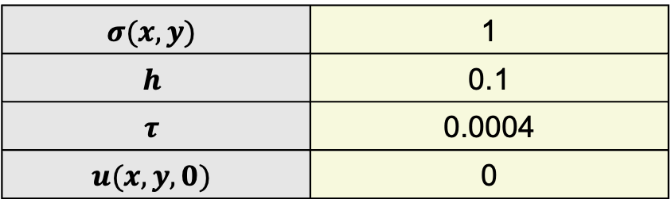
Result and analysis – FVM Solver
Table 1. Parameters
Accuracy of FVM Solver
$$σ(x,y)$$ | 1
$$h$$ | 0.1
$$τ$$ | 0.0004
$$u(x,y,0)$$ | 0

Slide 6
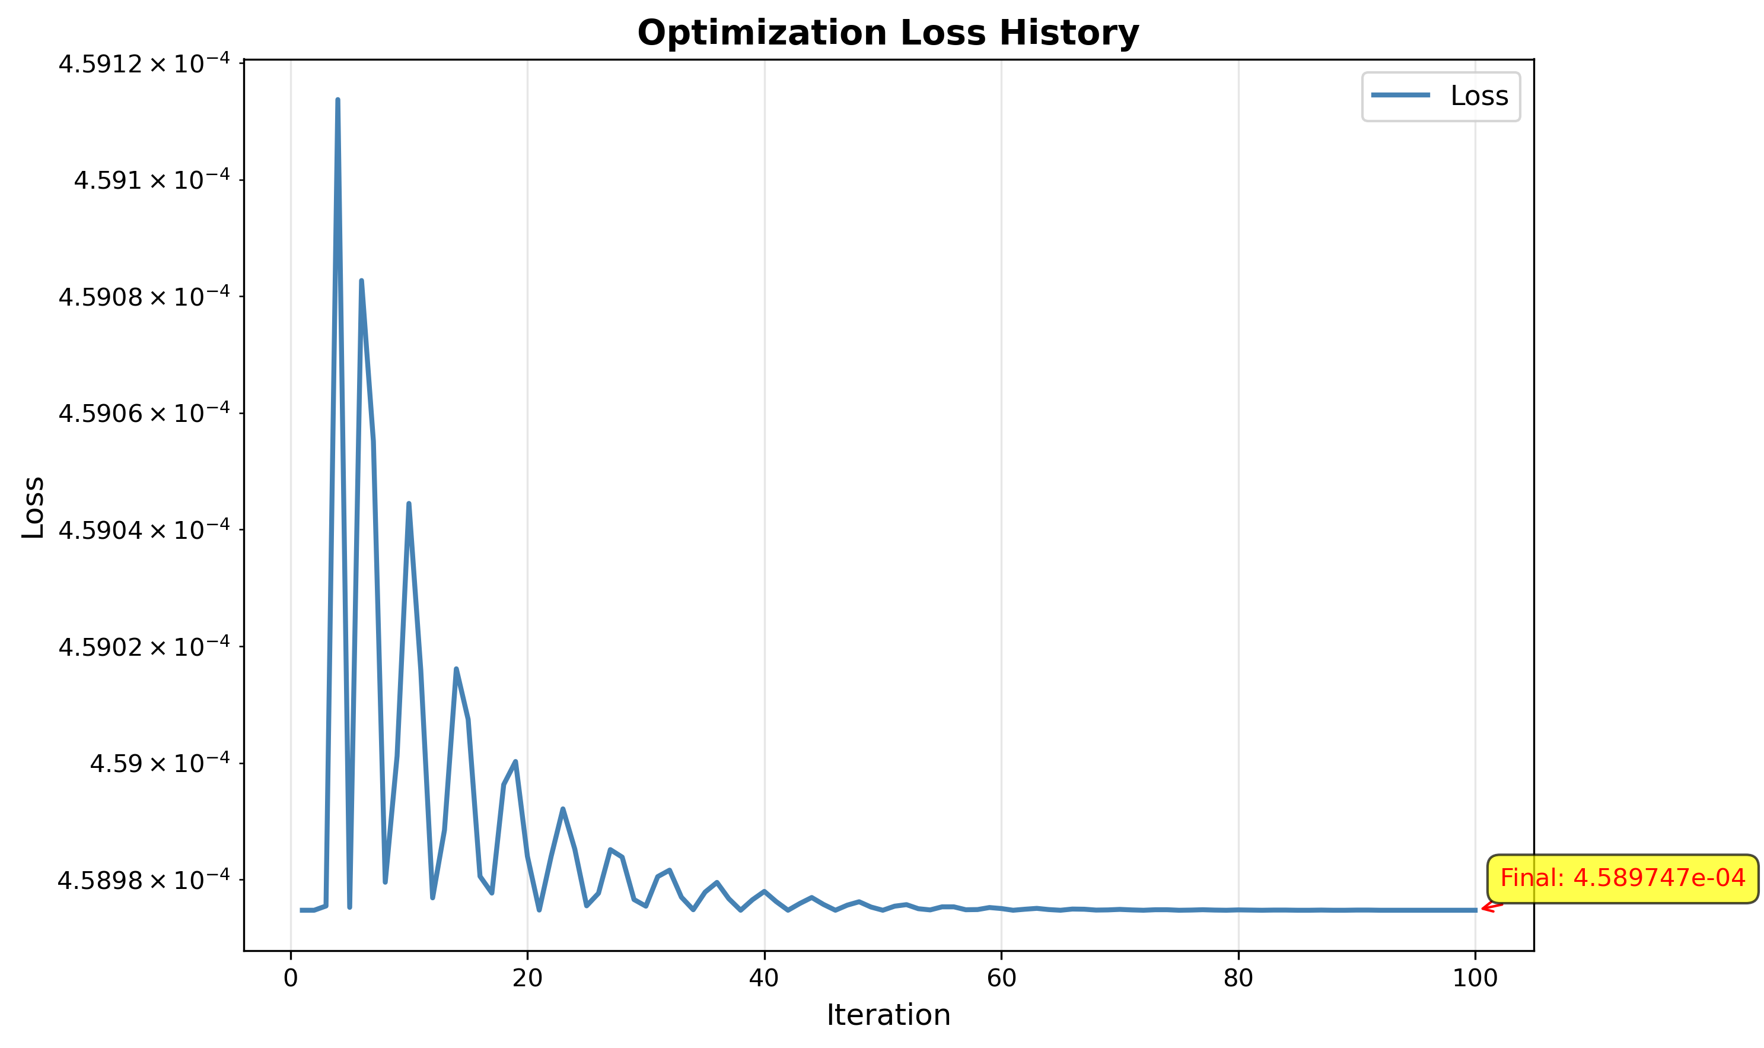
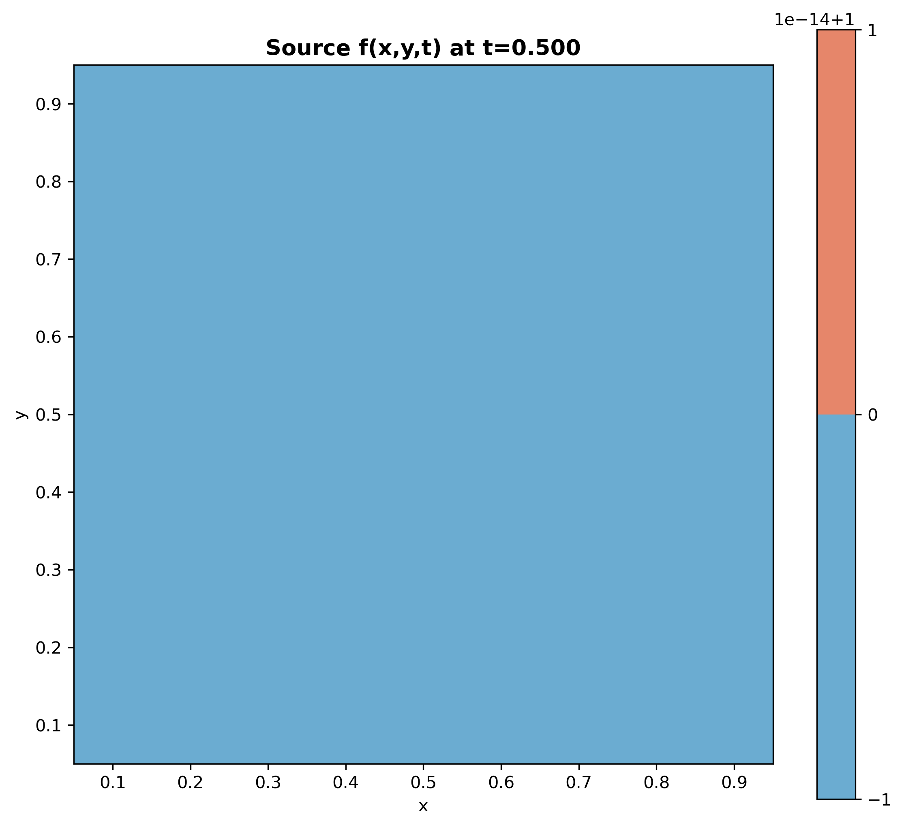
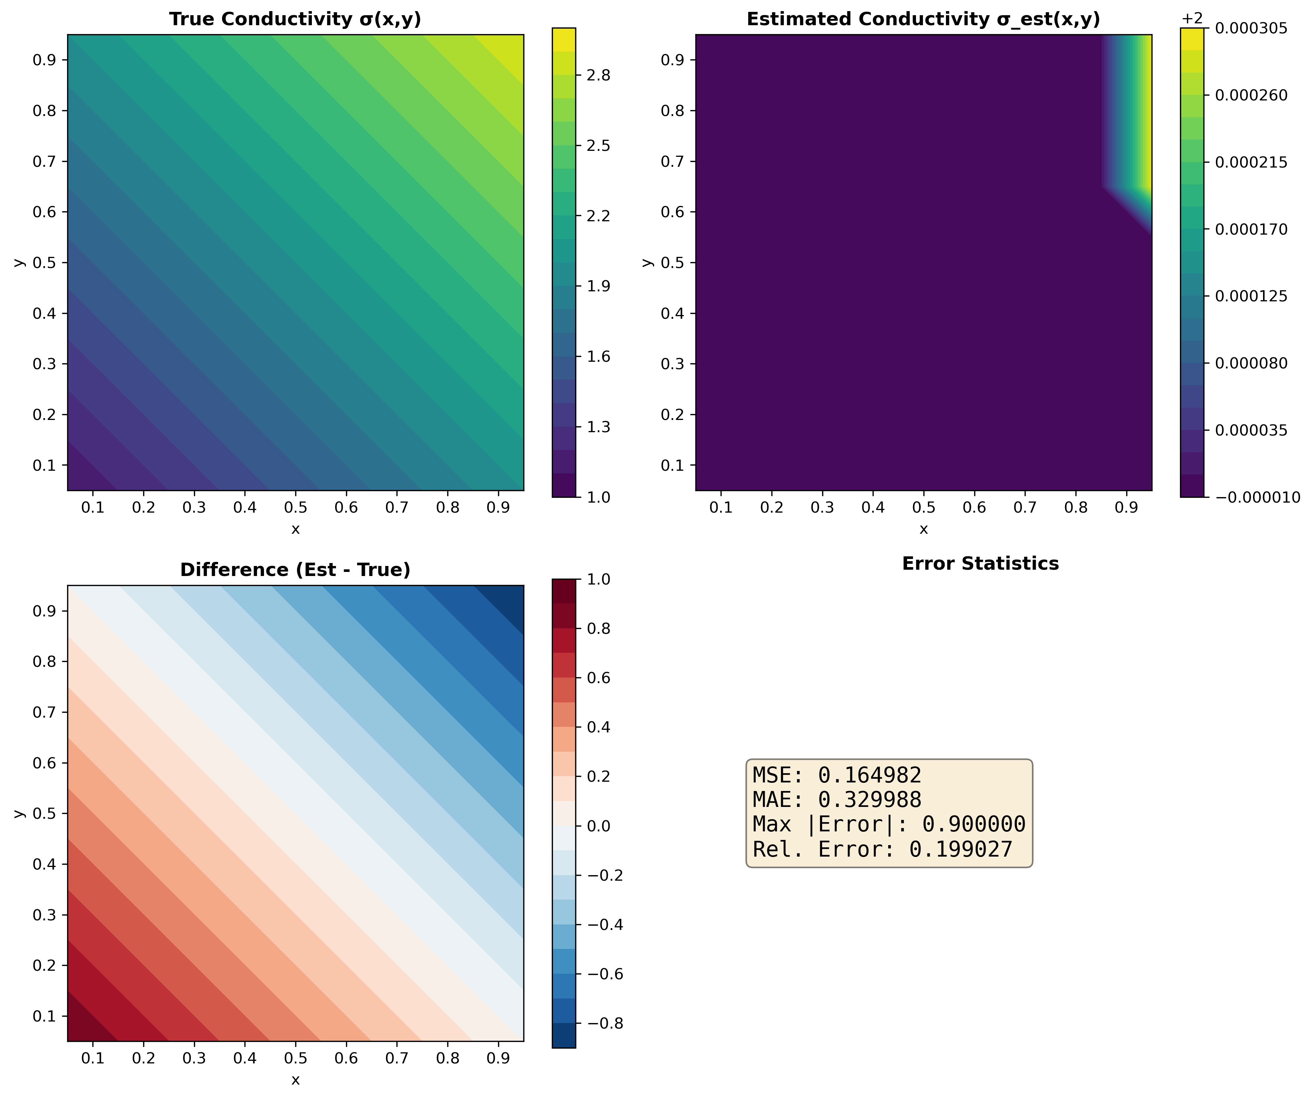
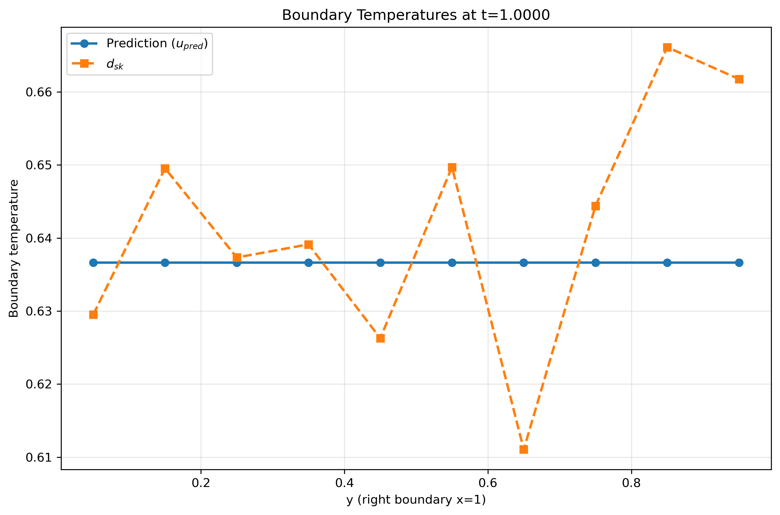
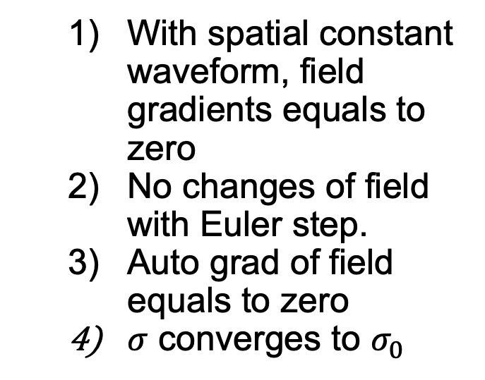

Result and analysis – Reverse Solver
Without spatial variation
$$f\left(x,y,t\right)=sinπt$$
With spatial constant waveform, field gradients equals to zero
No changes of field with Euler step.
Auto grad of field equals to zero
$σ$ converges to $σ_{0}$

Slide 7
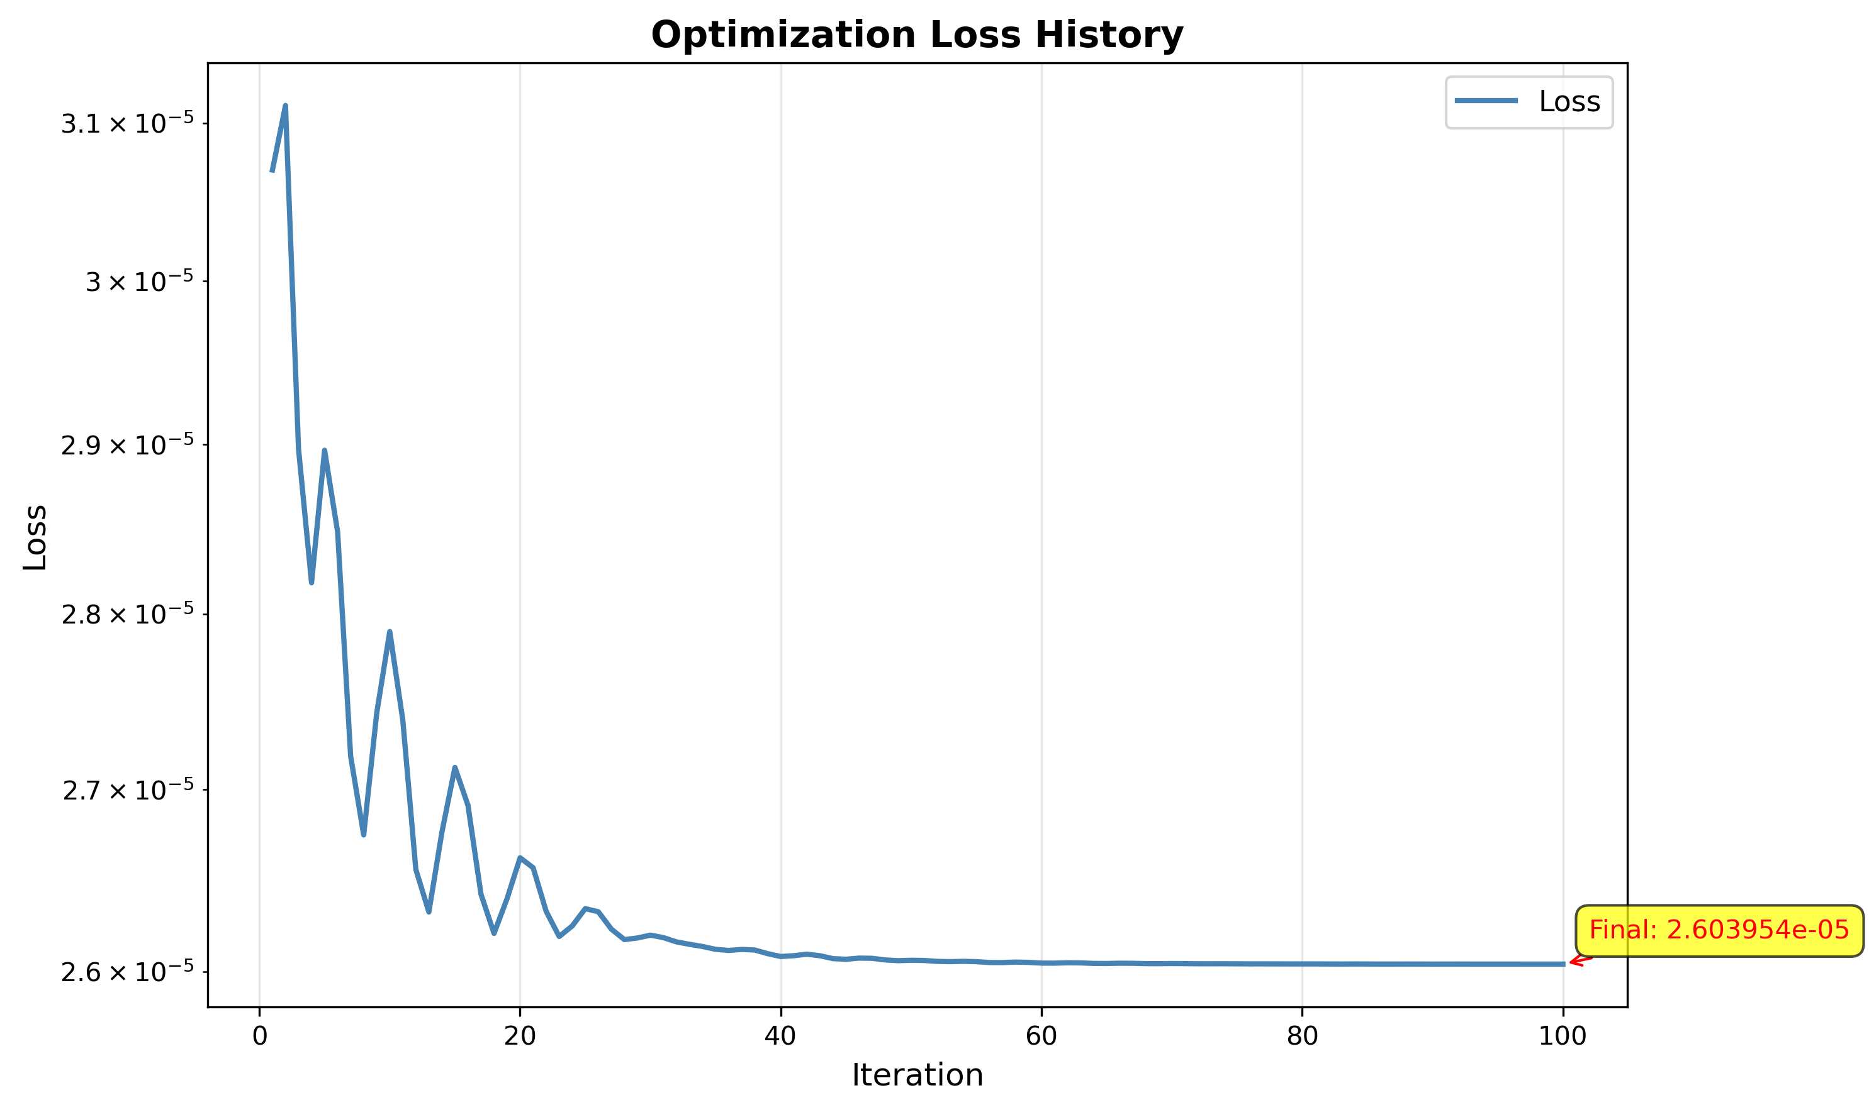
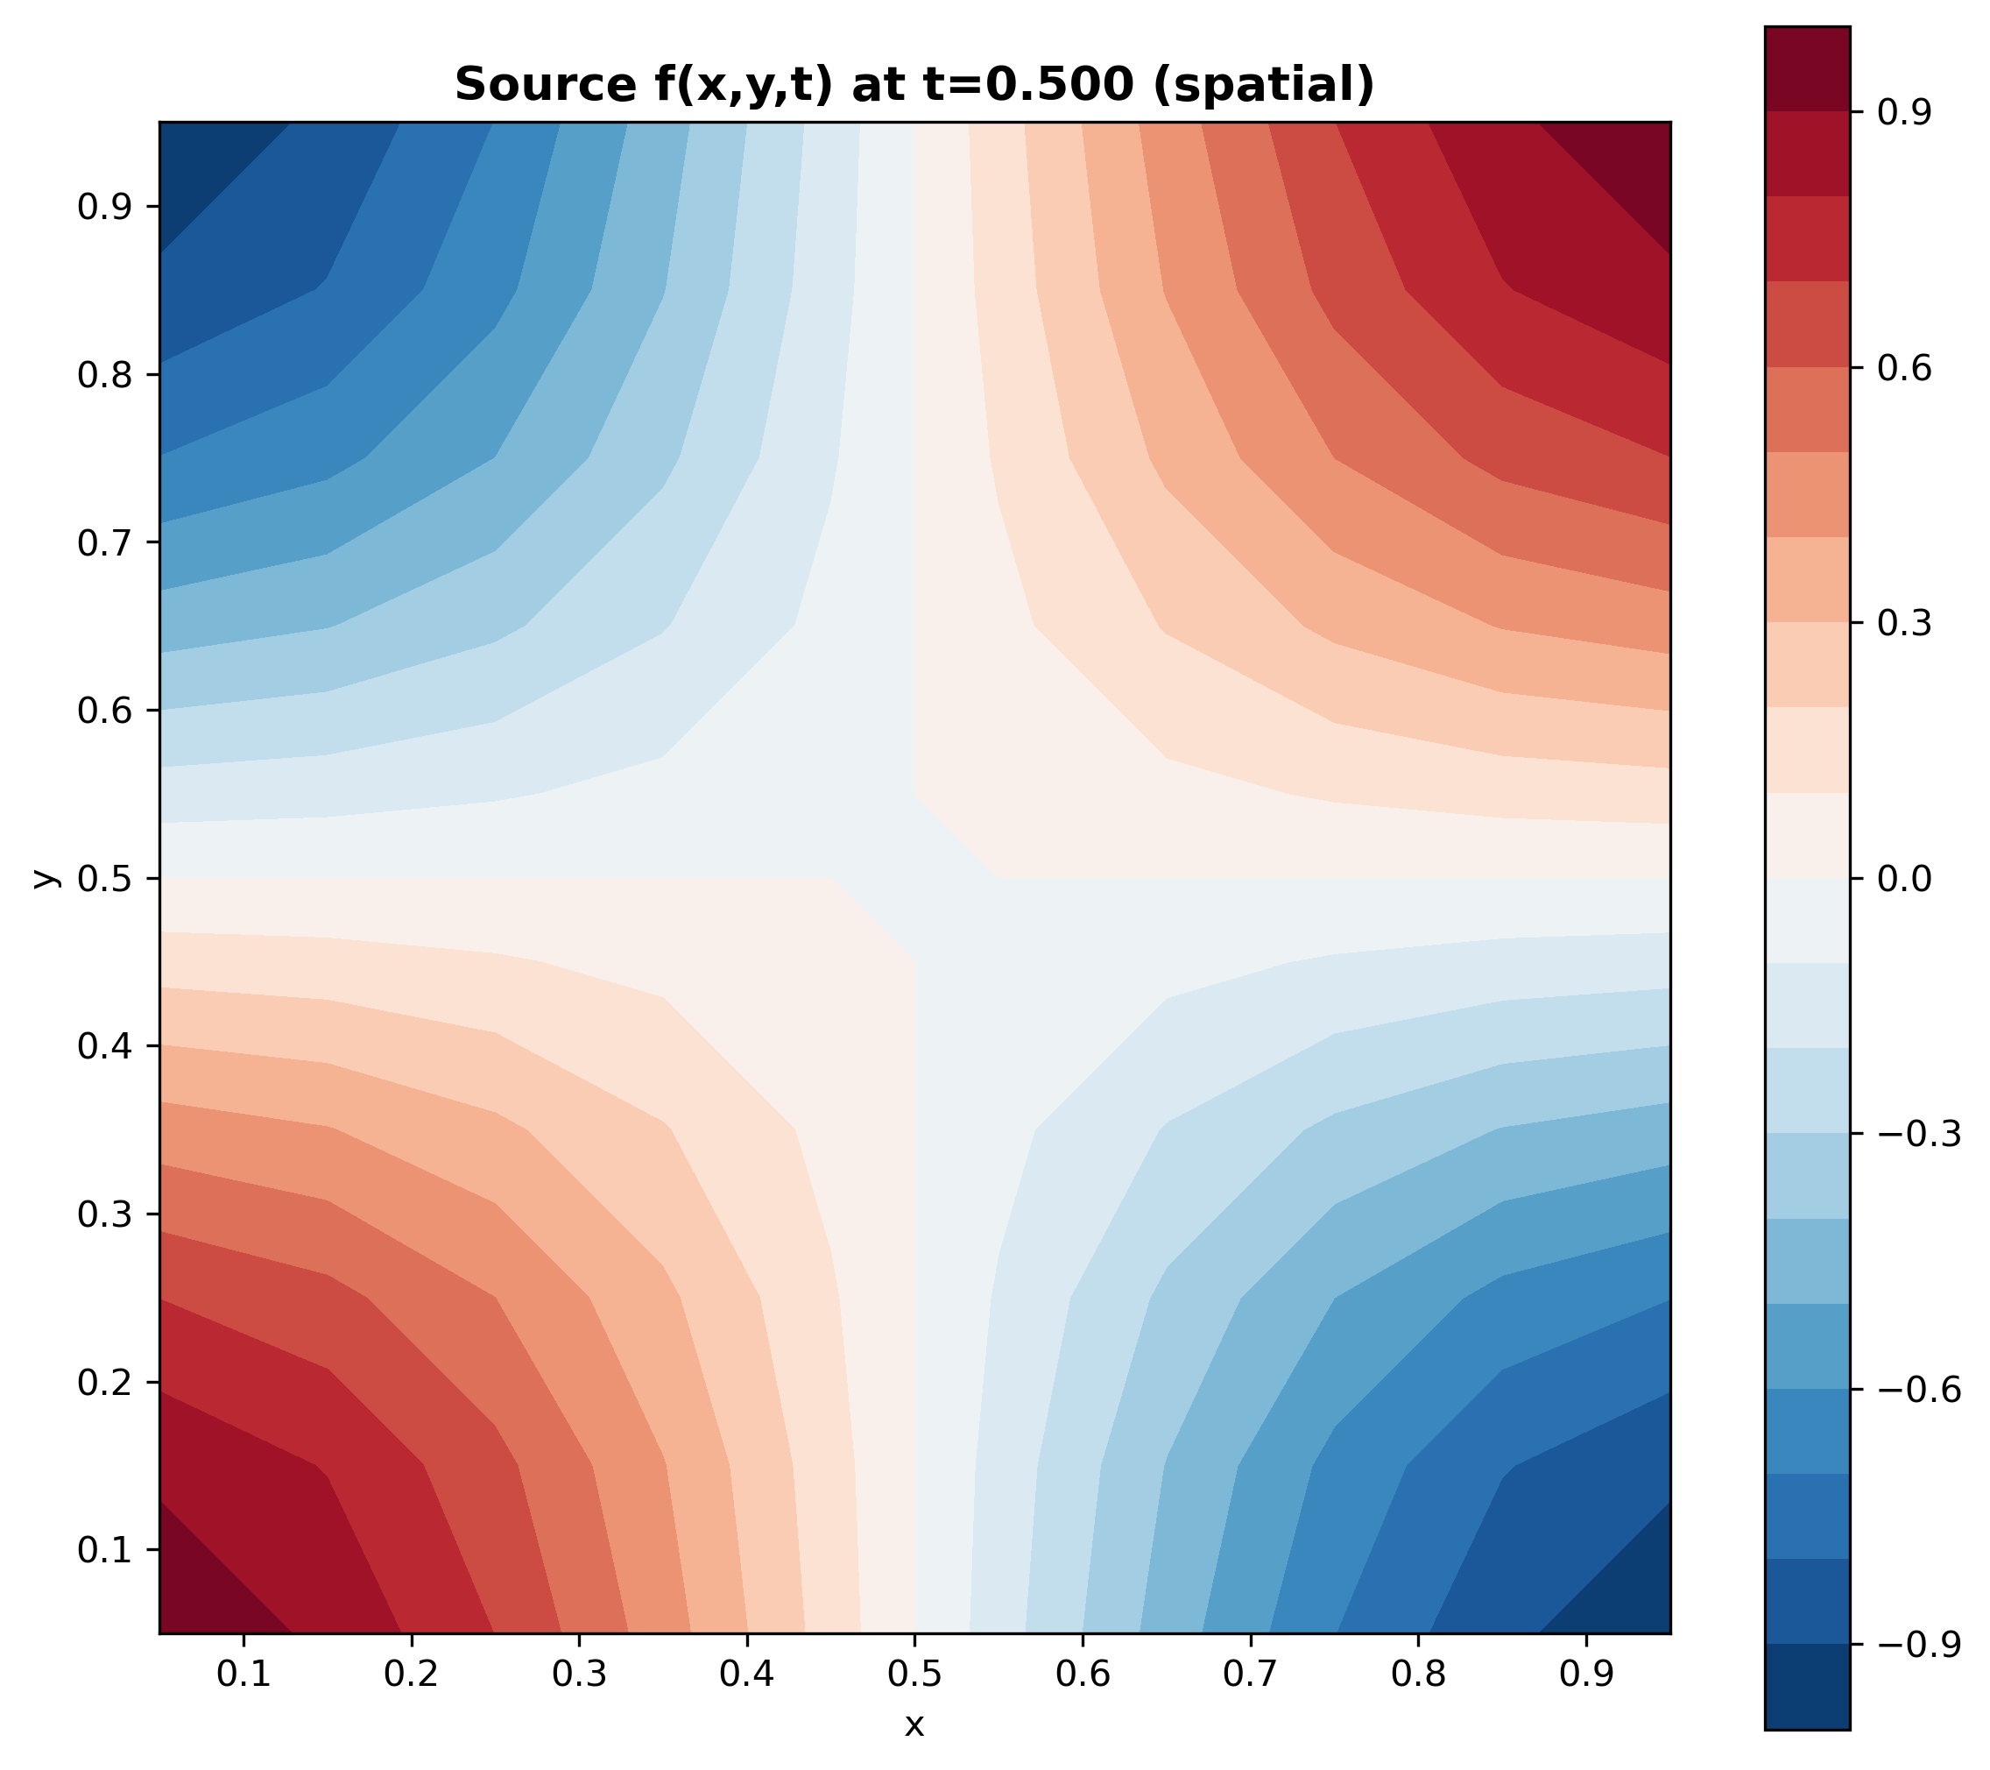
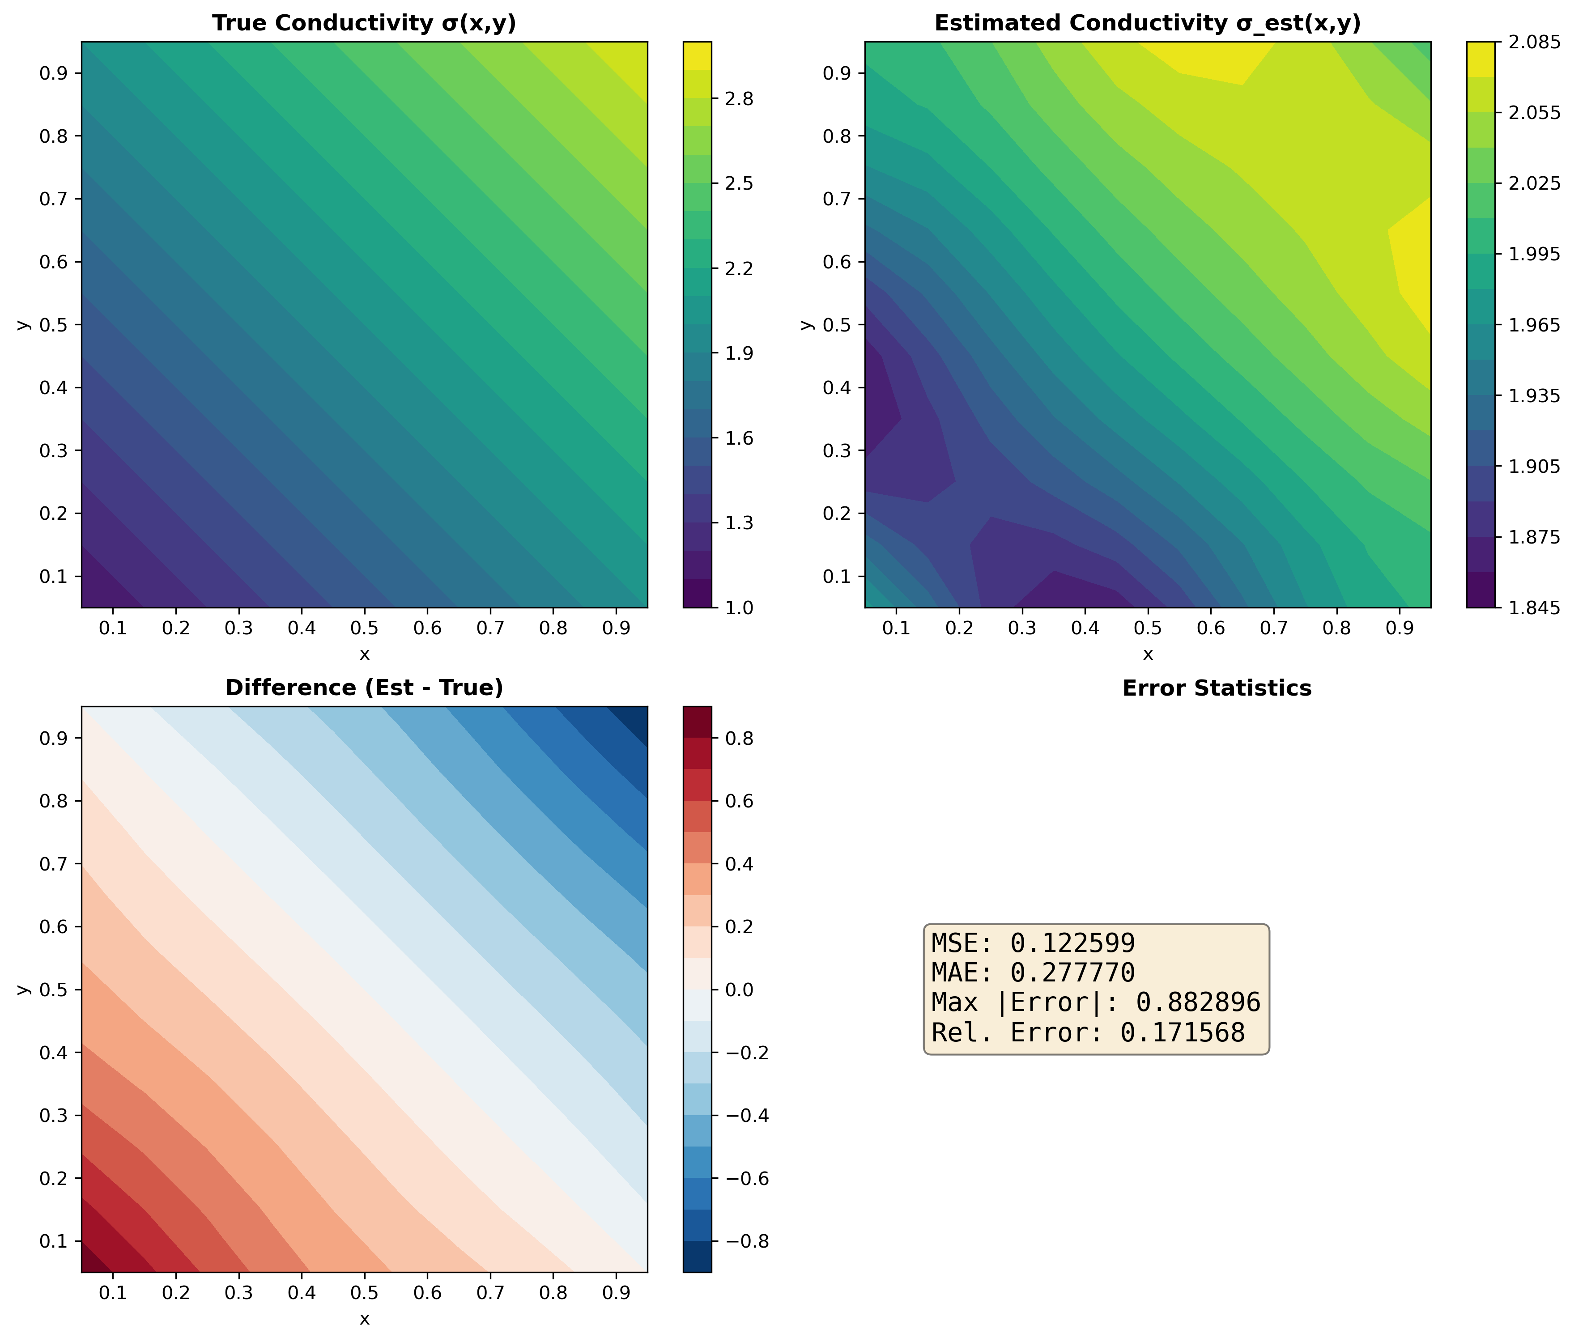
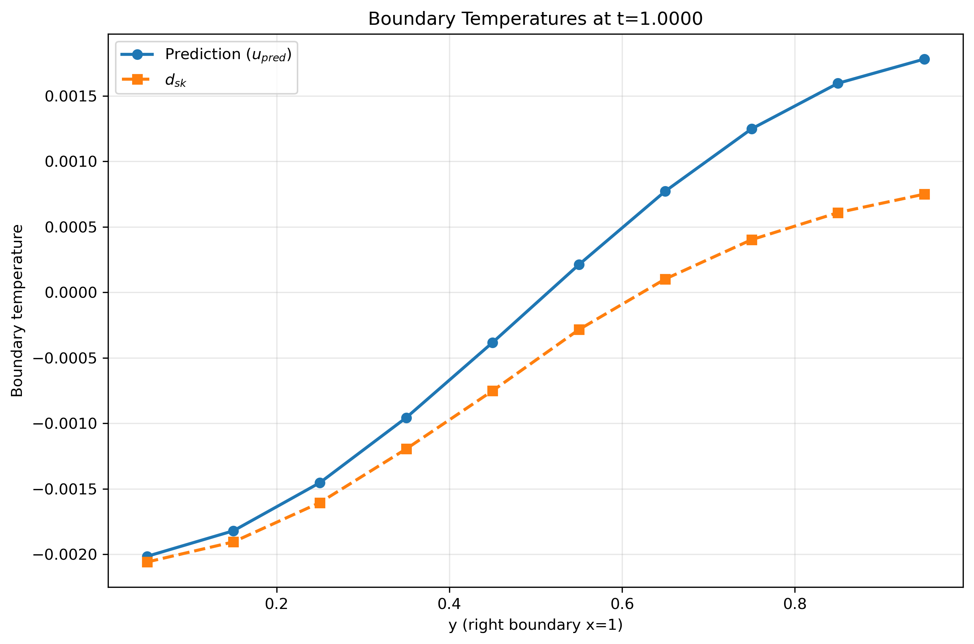

Result and analysis – Reverse Solver
With spatial variation
$$f\left(x,y,t\right)=sinπt∗cosπx∗cosπy$$
Spatial variation waveform
Able to use gradient descent algorithm
Limited accuracy with oscillation in time
unable to learn with gradient descent algorithm.

Slide 8
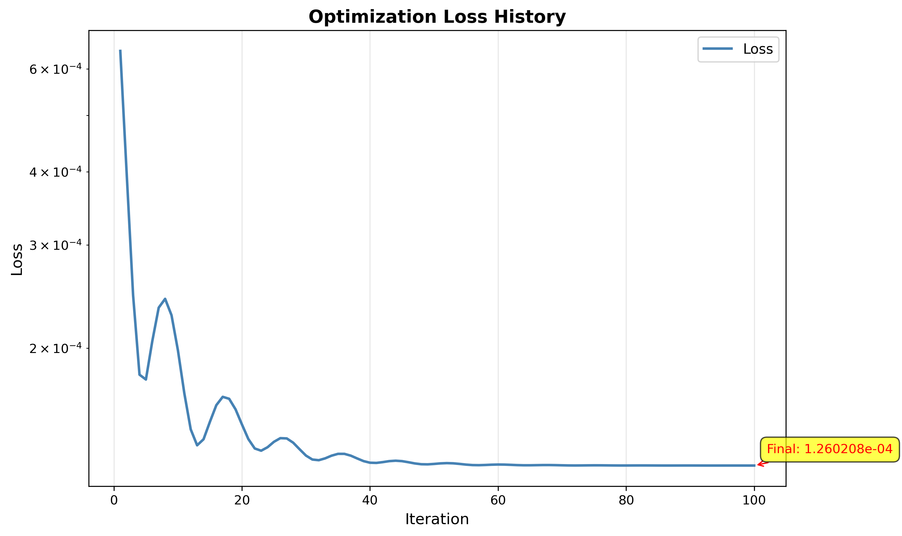
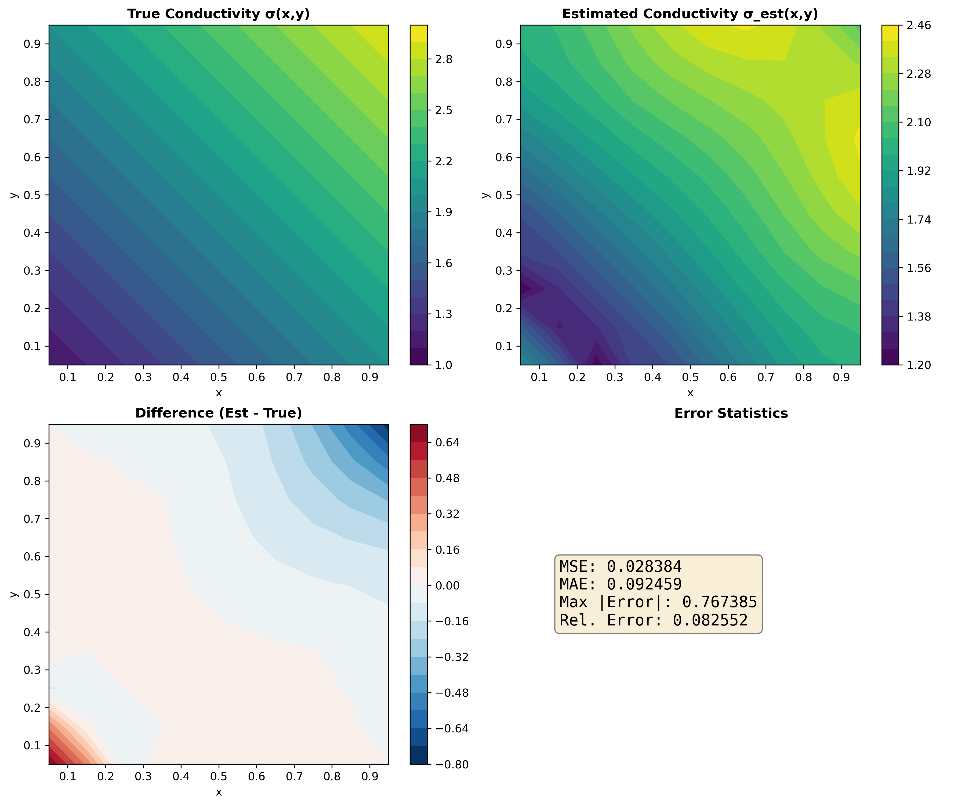
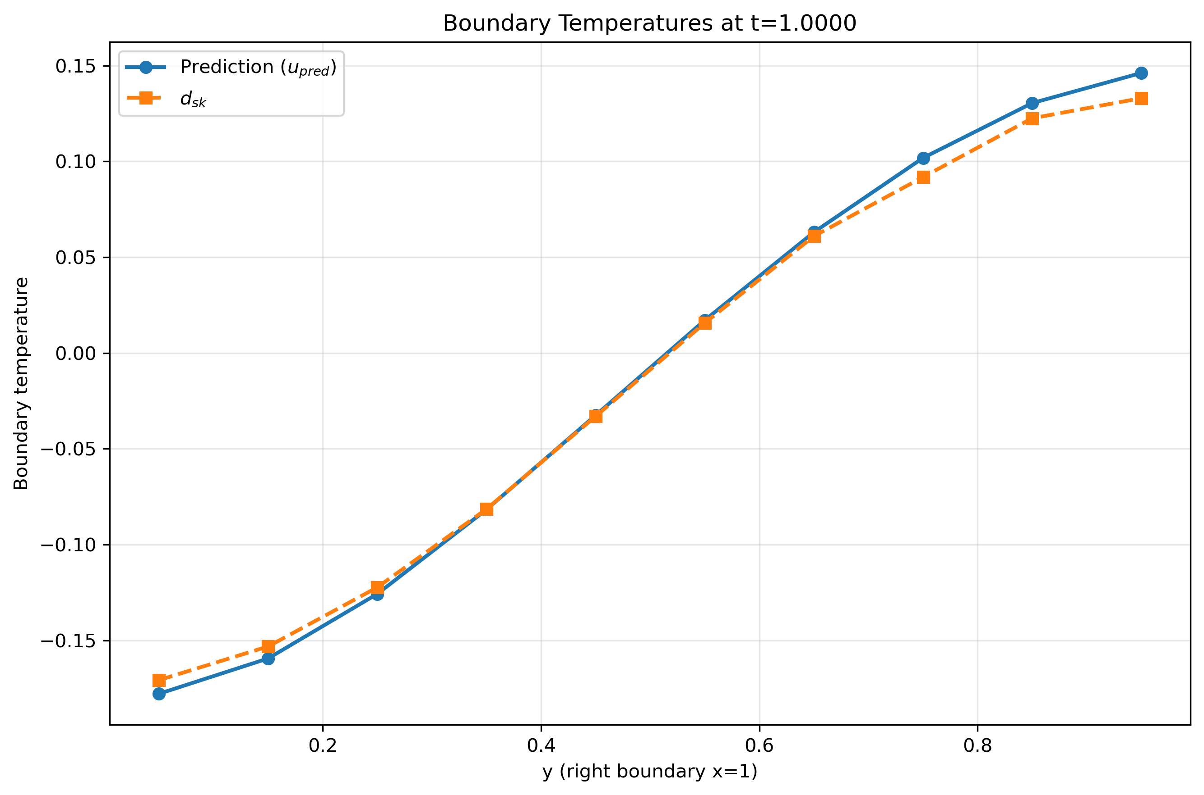

Result and analysis – Reverse Solver
With spatial variation
$$f\left(x,y,t\right)=e^{2t}∗cosπx∗cosπy$$
Spatial variation waveform
Able to use gradient descent algorithm
Increased accuracy
unable to learn with gradient descent algorithm.

Slide 9
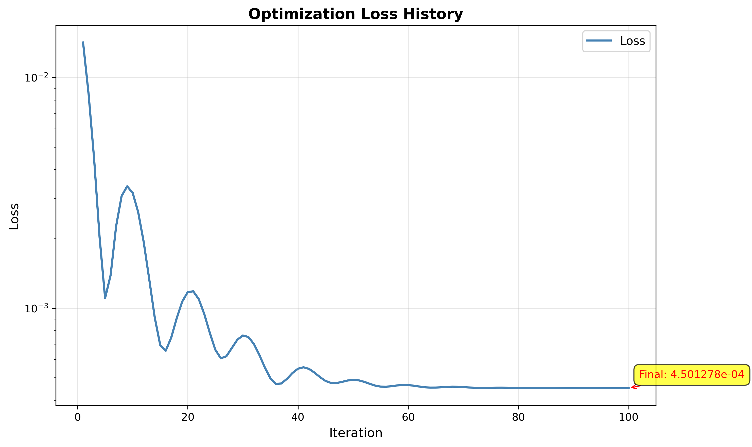
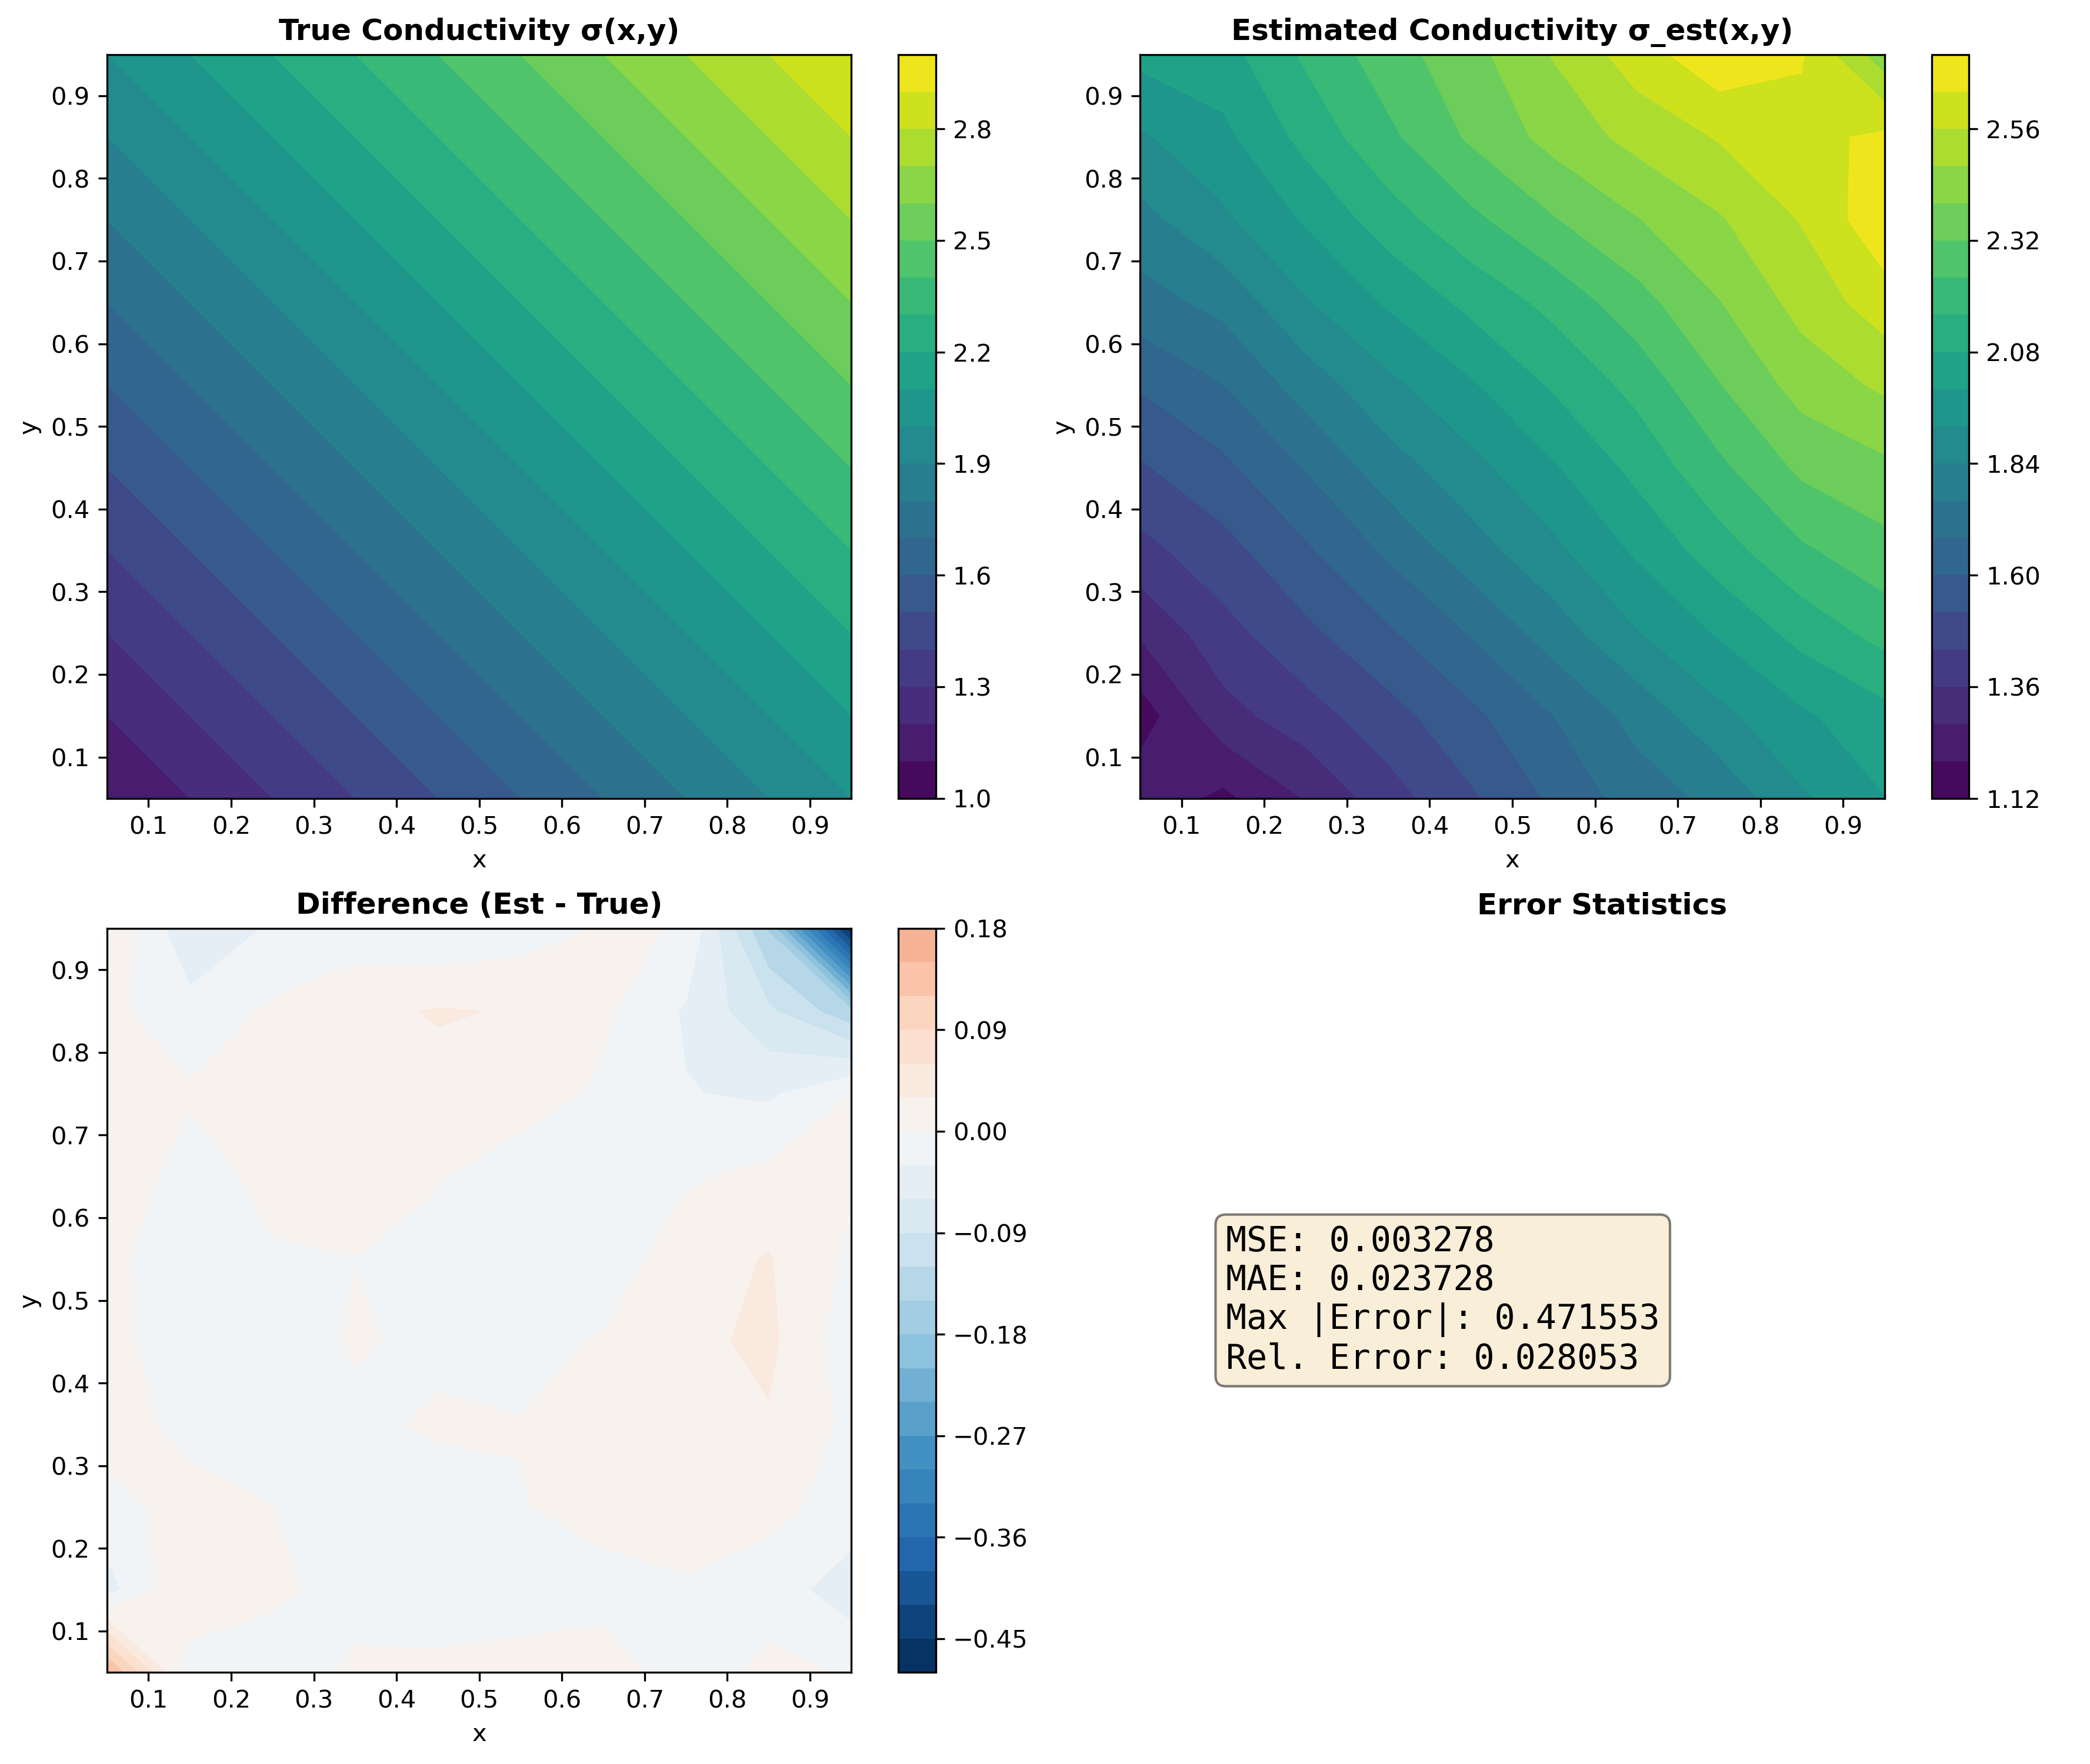
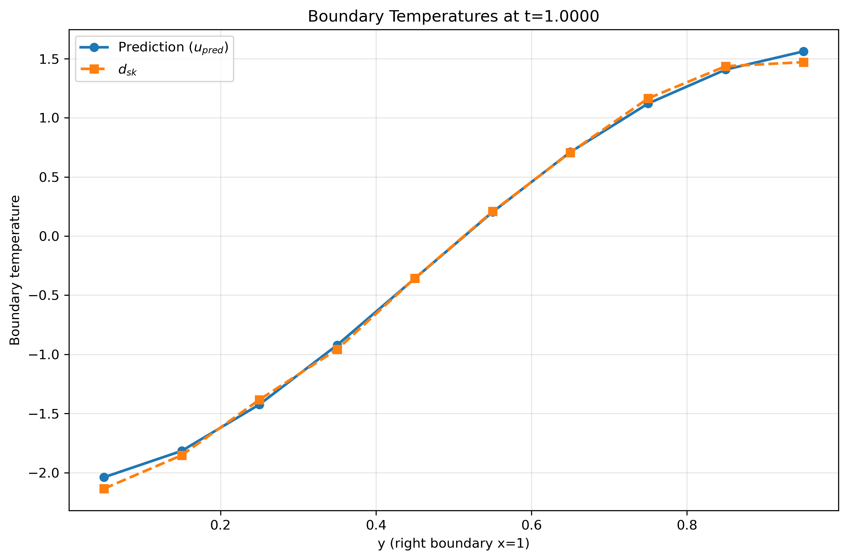

Result and analysis – Reverse Solver
With spatial variation
$$f\left(x,y,t\right)=e^{4t}∗cosπx∗cosπy$$
Spatial variation waveform
Increased exponential time
Increasing accuracy
unable to learn with gradient descent algorithm.

Slide 10
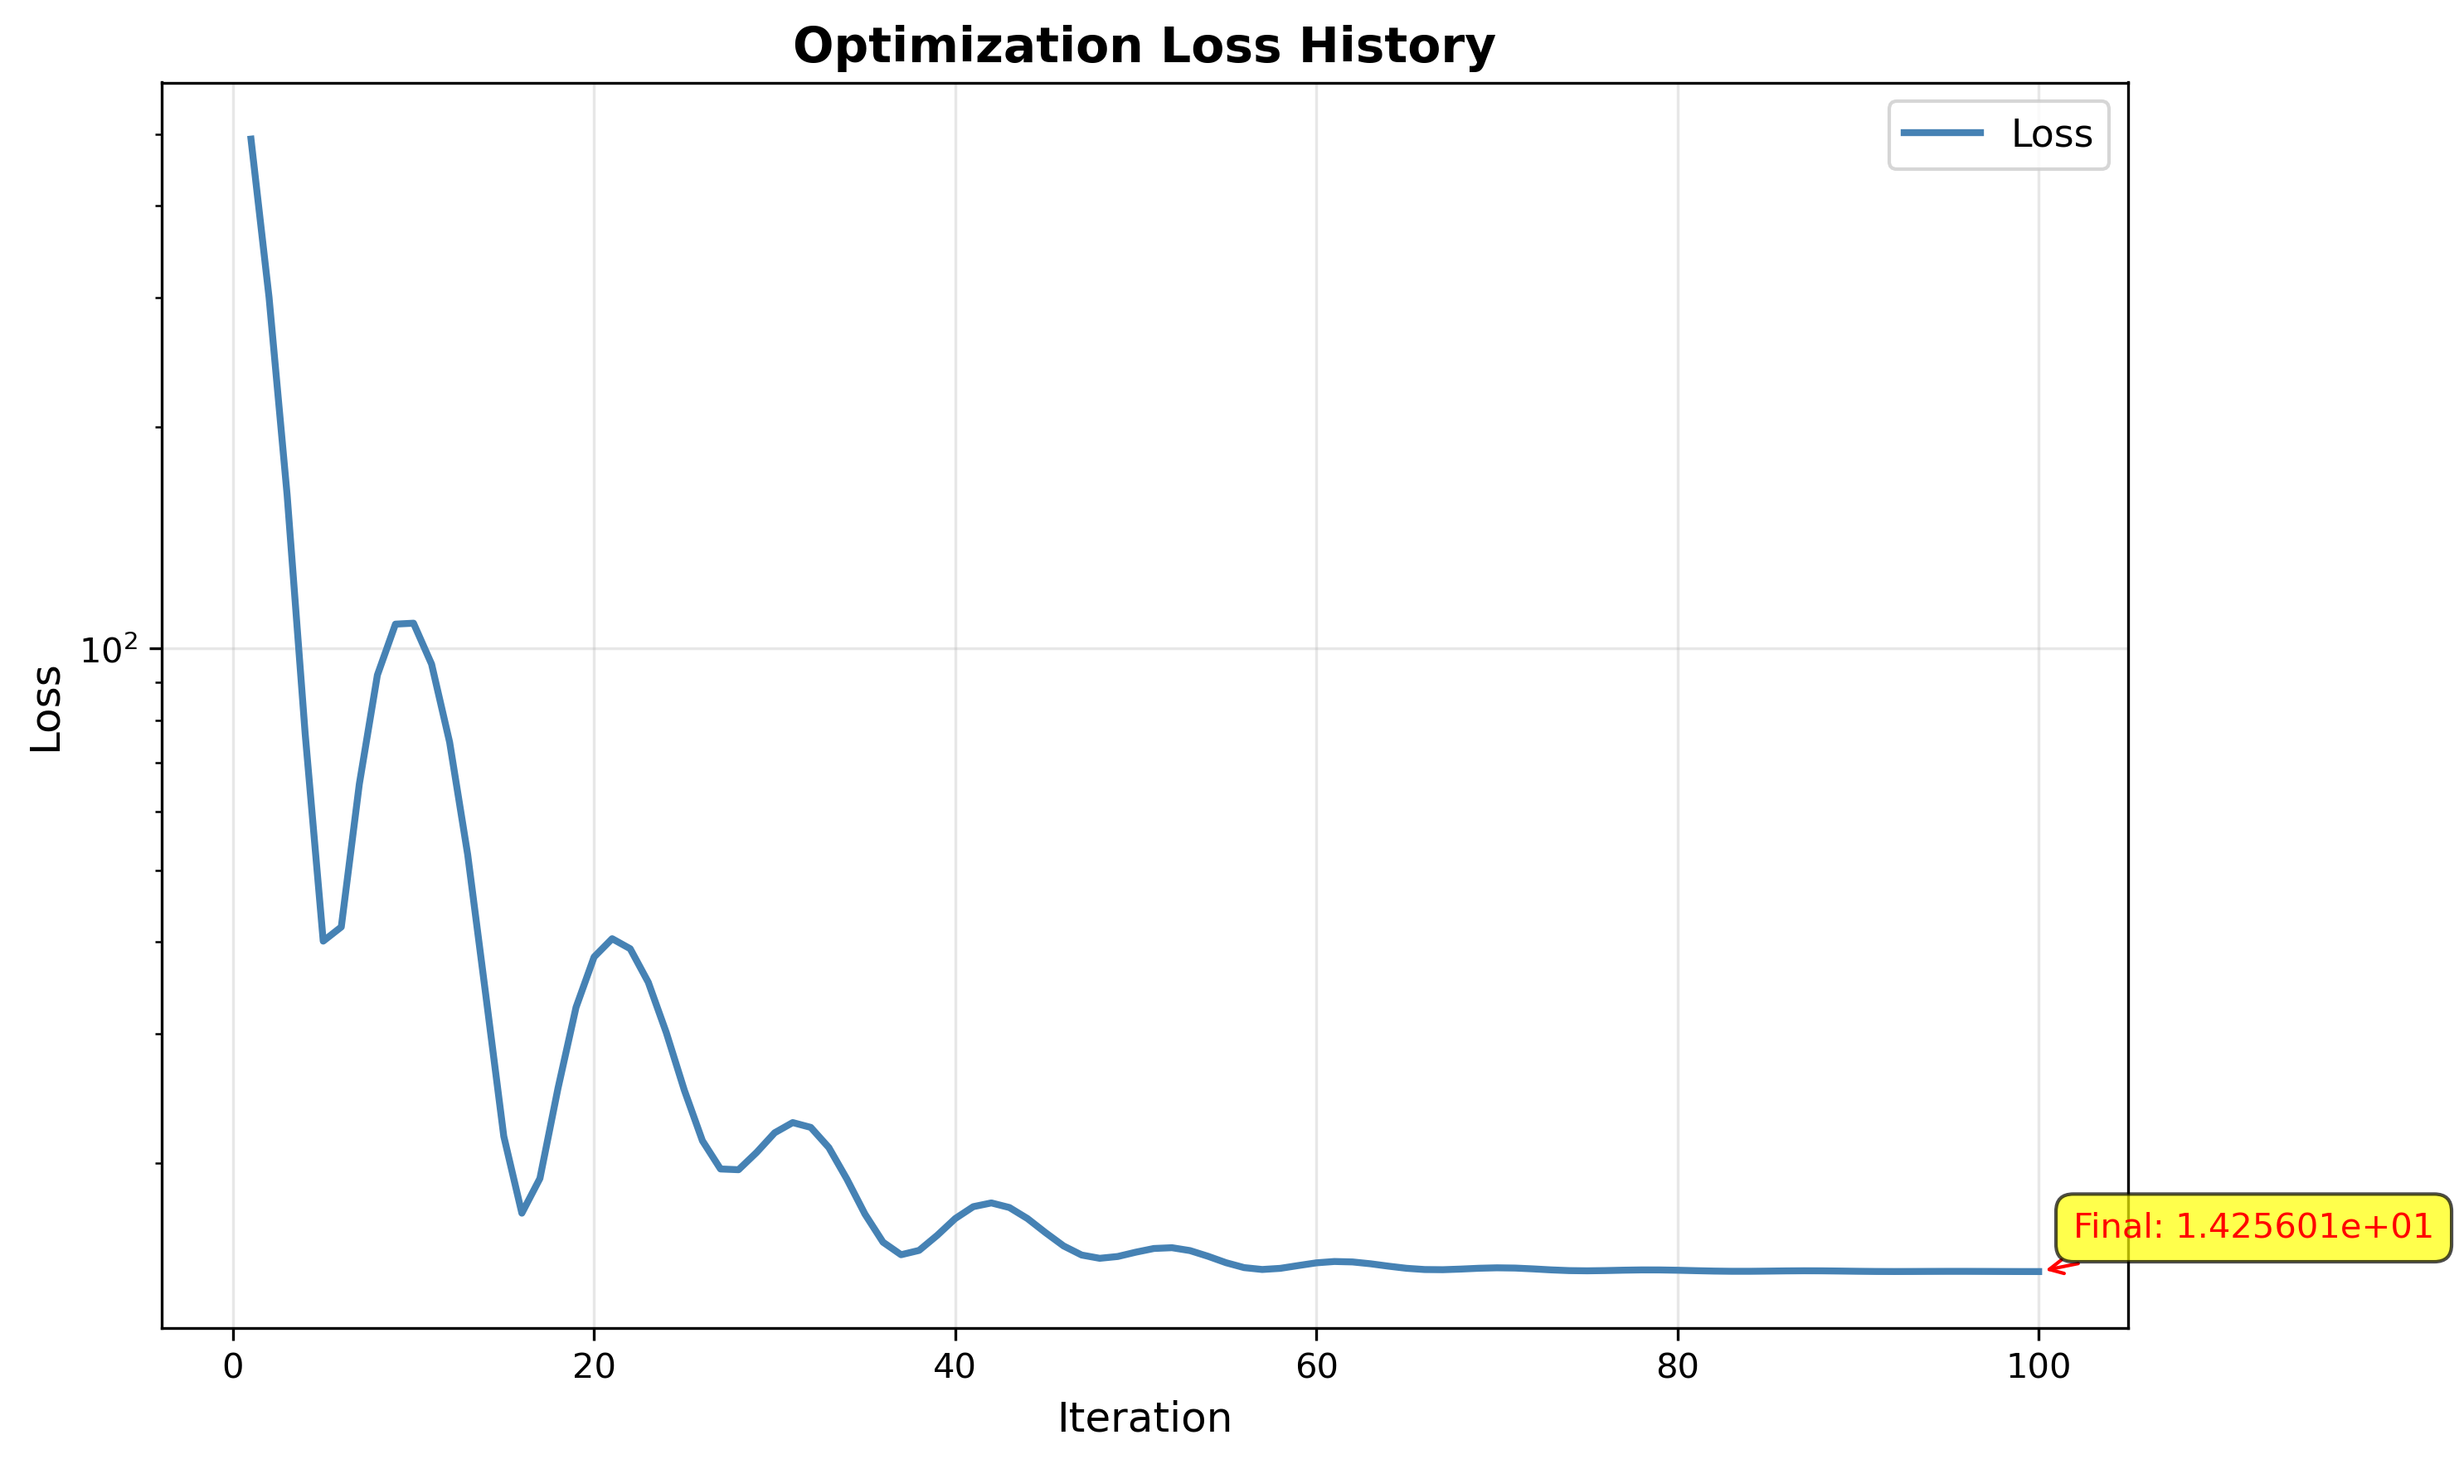
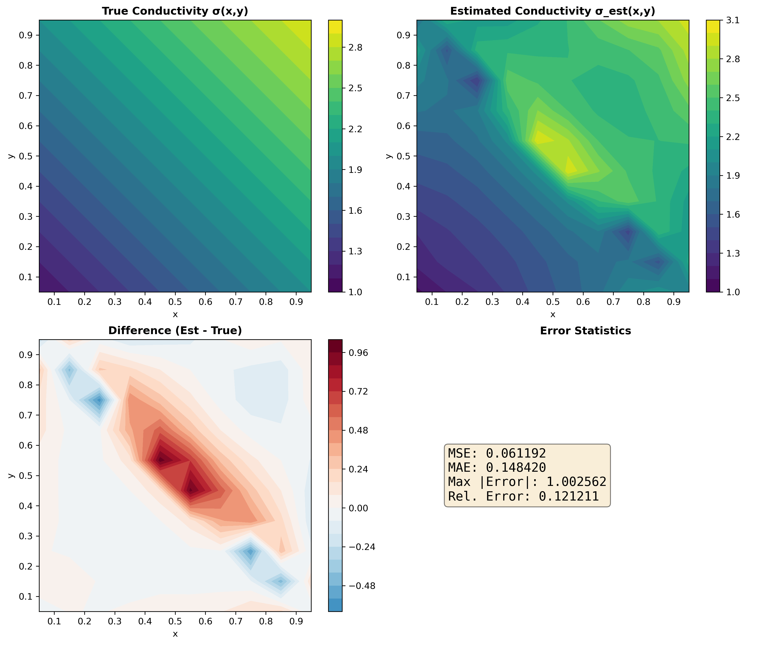
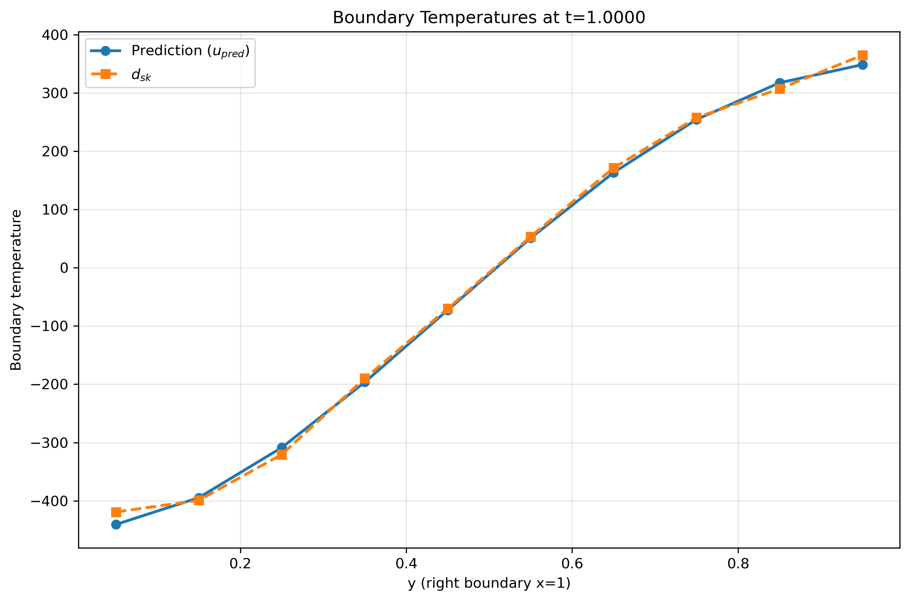

Result and analysis – Reverse Solver
With spatial variation
$$f\left(x,y,t\right)=e^{10t}∗cosπx∗cosπy$$
Spatial variation waveform
With exponential time
Over fitting
unable to learn with gradient descent algorithm.

Slide 11
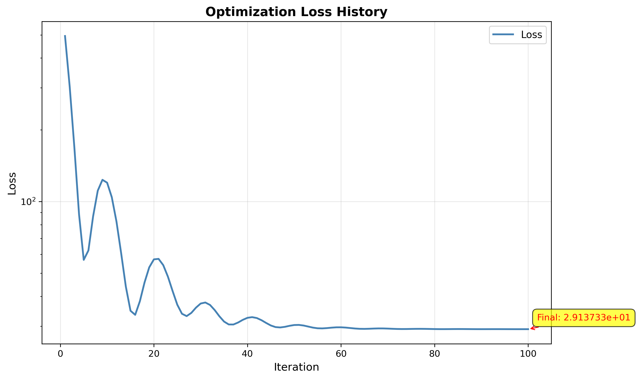
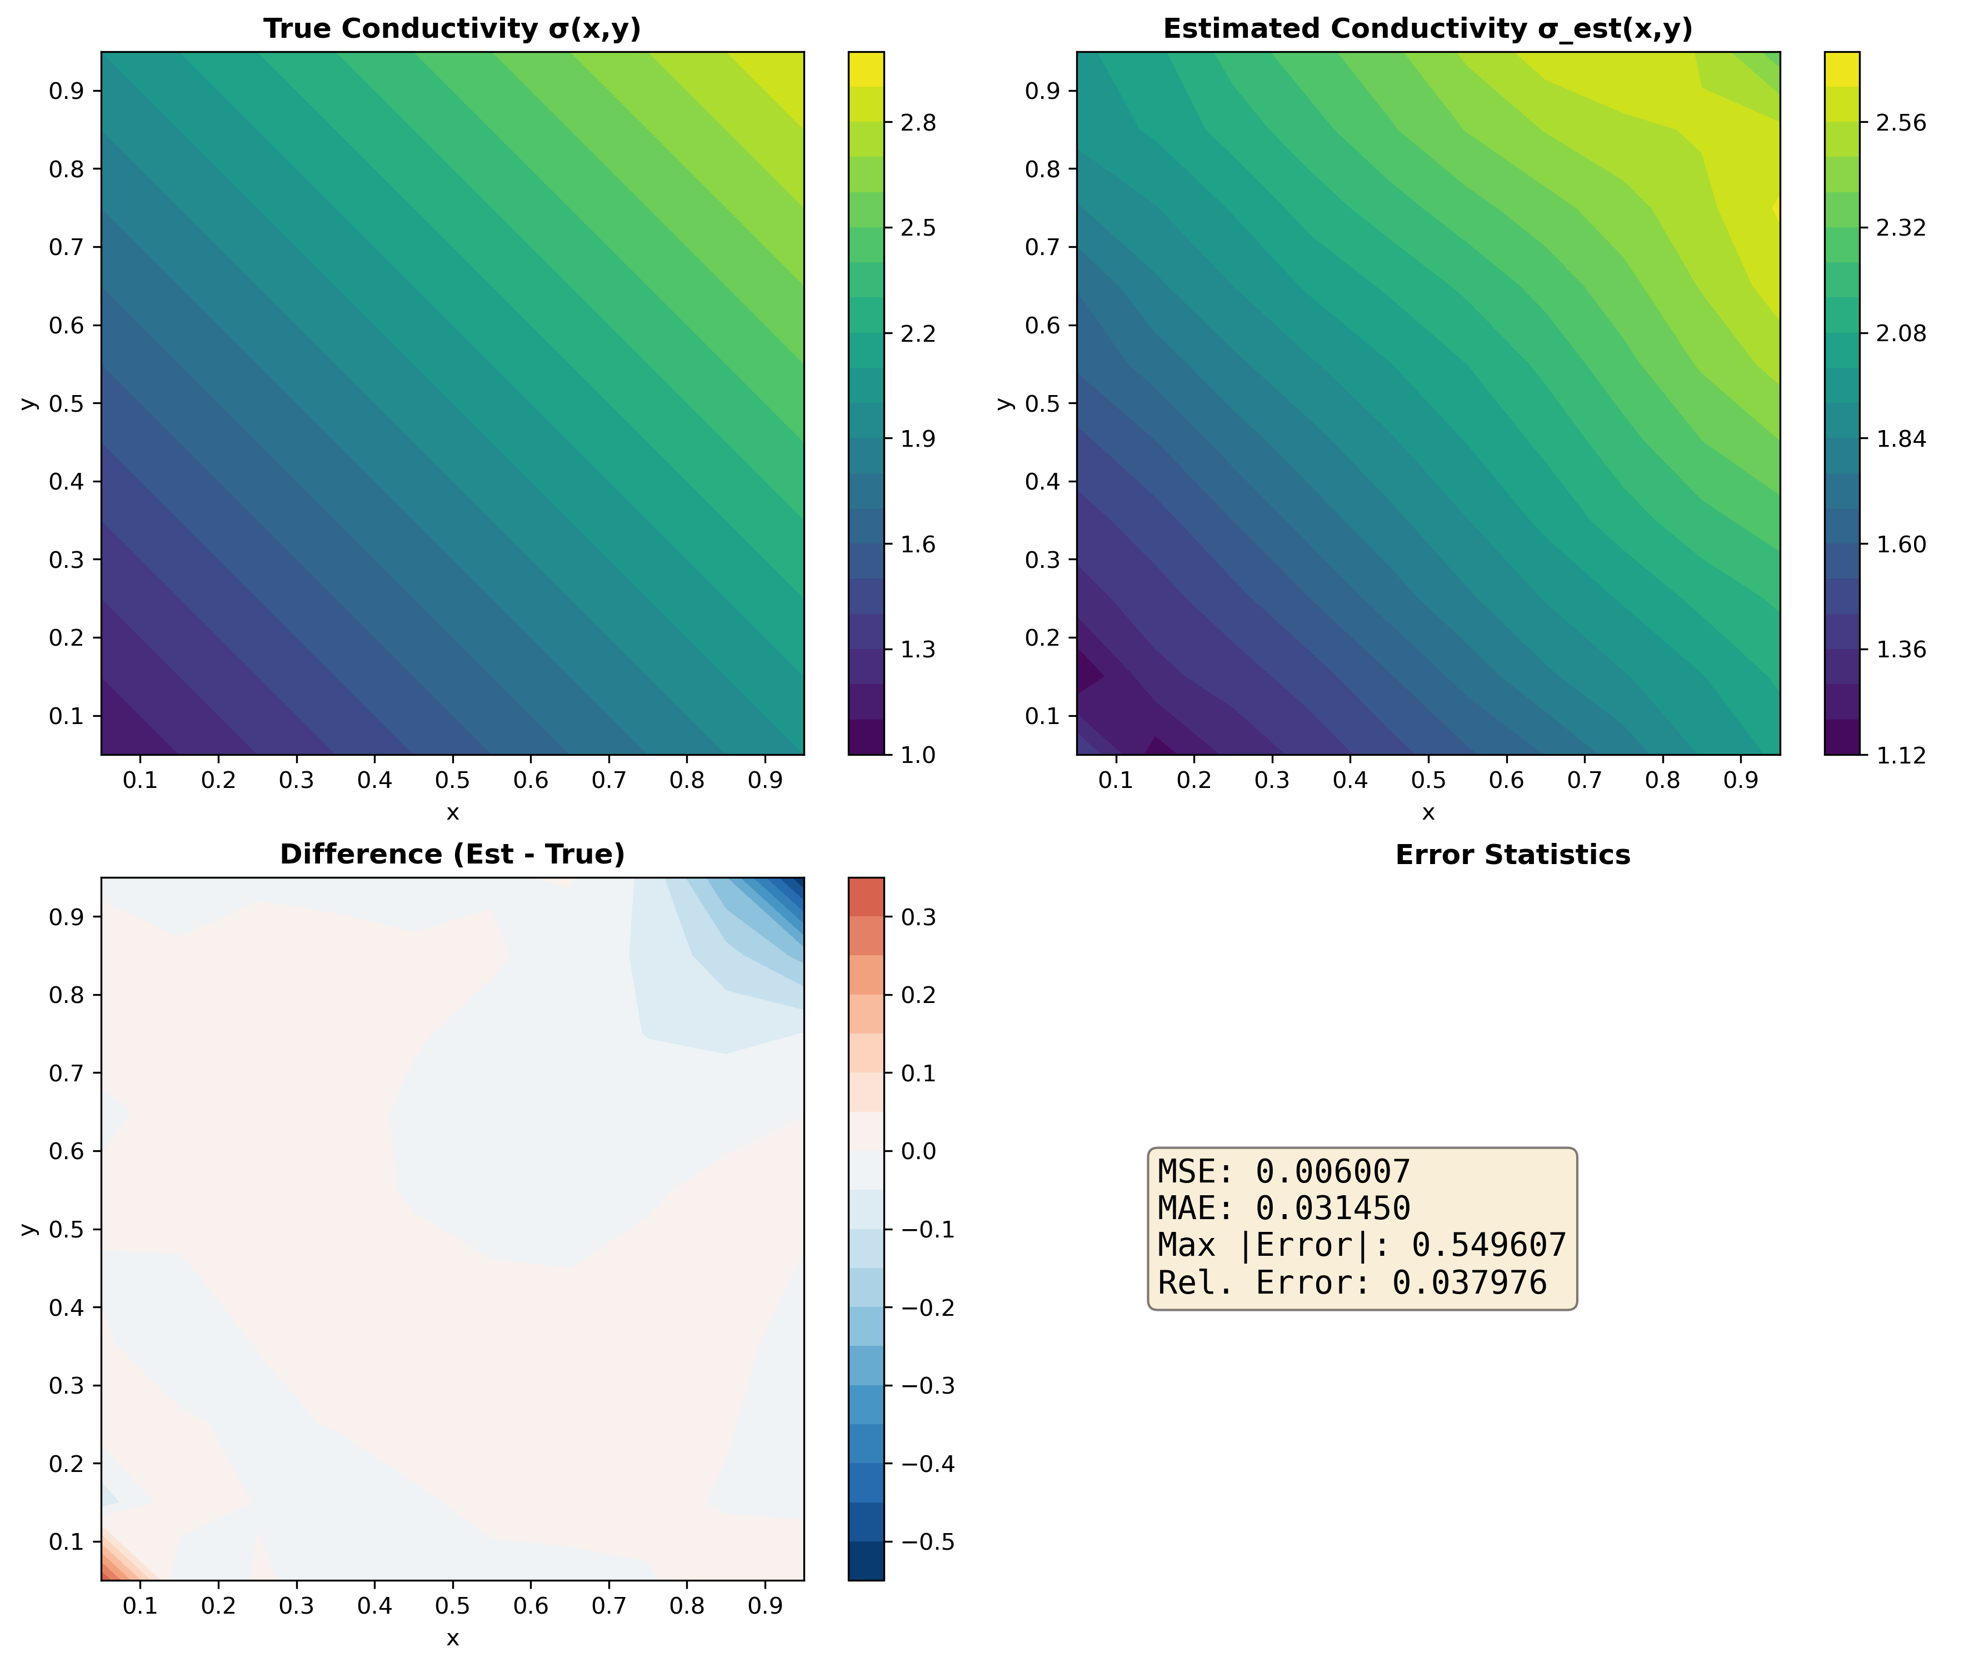
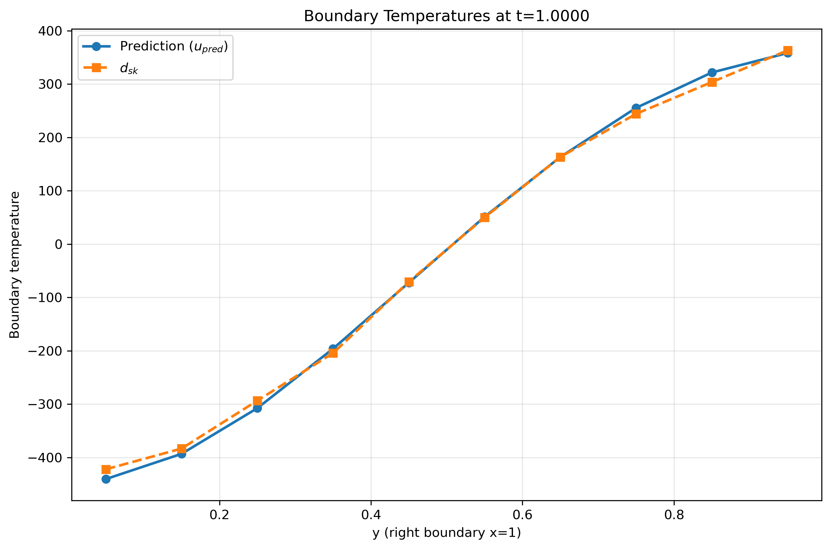
Result and analysis – Reverse Solver
With spatial variation
$$f\left(x,y,t\right)=e^{10t}∗cosπx∗cosπy$$
$$α↑$$

Slide 12
Discussion and conclusion

